Slide 1
Simple Present
Tegar Arif Topan

Slide 2
Simple Present
To talk about :
Action that happens repeatedly (habitual action).
General or permanent situation.
Something is true or untrue in general.
Thoughts, feelings and states.
In storytelling and commentaries used to describes the main events.
An official arrangement such as a timetable or programme.
Also used for facts.

Slide 3

Simple Present
Always
Usually
Clue Words
Never
Often
Sometimes

Slide 4
Simple Present
Affirmative Structure : Subject + Verb (present form)
Subject | Verb
I | Play
You | Play
He, She, It | Plays
We | Play
They | Play

Slide 5
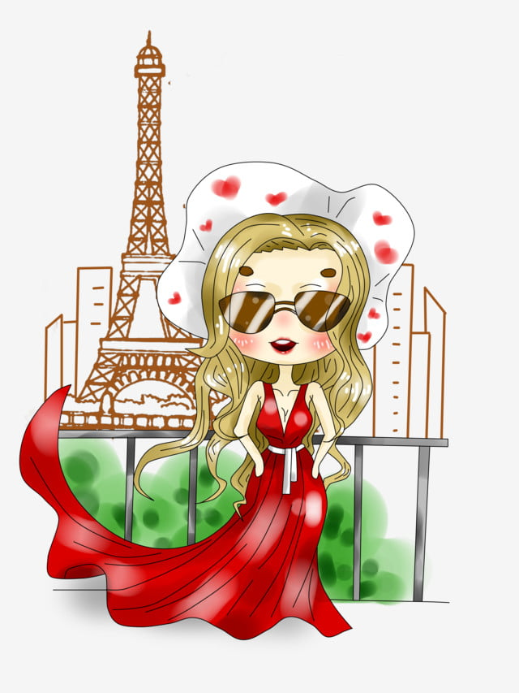
Simple Present
Example :
She lives in Paris.
The earth turns 360º every day.
I always drink milk at breakfast.

Slide 6
Simple Present
Negative Structure : Subject + do / does + not + verb
Subject | Do / Does + not | Verb
I | Don’t | Play
You | Don’t
He, She, It | Doesn’t
We | Don’t
They | Don’t

Slide 7
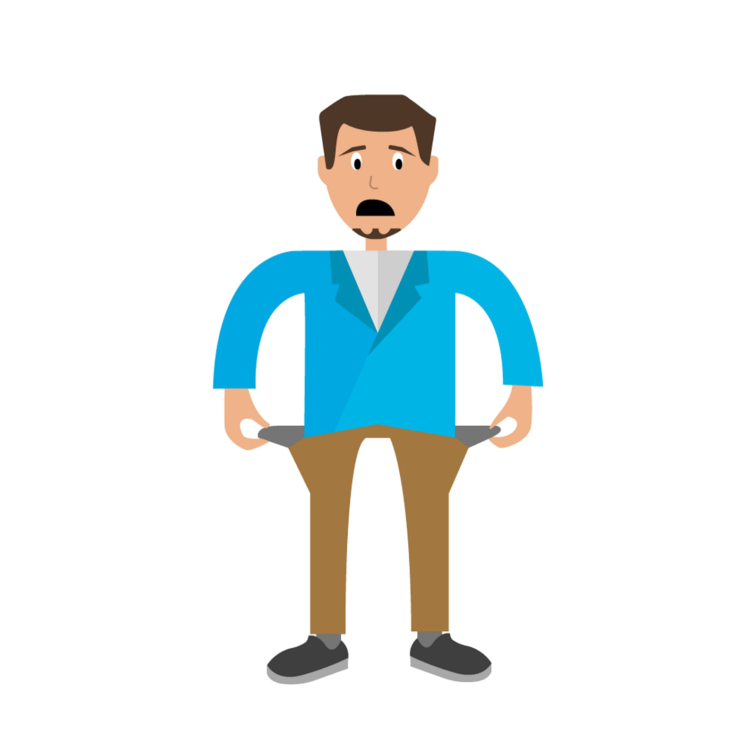
Simple Present
Example :
She doesn’t seem very happy at the moment.
I don’t believe! Is that really true?
We don’t have much money, so we rarely have vacation.

Slide 8
Simple Present
Interrgoative Structure : do / does + subject + verb
Do / Does | Subject | Verb
Do | I | Play?
Do | You
Does | He, She, It
Do | We
Do | They

Slide 9

Simple Present
Example :
Does she listen to music?
Do you hate me?
Do I love her?

